Slide 1
BI Unit III- Part 2 Topic: Business Intelligence Architecture
Topic: Data Mining, its Properties and Tasks
Presented by: Drashti Shrimal1 Topic: Data Mining, its Properties and Tasks

Slide 2
Topics :
- Dimensional Modeling
- Elements of DM
- Example
- Steps of DM
- Star schema
- Snowflake schema
- Galaxy schema

Slide 3
Dimensional Modeling
Dimensional Modeling (DM) is a data structure technique optimized for data storage in a Data warehouse.
The purpose of dimensional modeling is to optimize the database for faster retrieval of data.
The concept of Dimensional Modelling was developed by Ralph Kimball and consists of “fact” and “dimension” tables.

Slide 4
Elements of DM
Fact
Facts are the measurements/metrics or facts from your business process. Example: for a sales business process, fact can be the sales figures.
Dimension
Dimension provides the context surrounding a business process event. In simple terms, they give who, what, where of a fact. In the Sales business process, for the fact quarterly sales number, dimensions would be
Who – Customer Names
Where – Location
What – Product Name

Slide 5
Elements of DM
Attributes
The Attributes are the various characteristics of the dimension in dimensional data modeling.
In the Location dimension, the attributes can be State, Country and Zipcode etc.
Fact Table
A fact table is a primary table in dimension modelling.
A Fact Table contains-
Measurements/facts
Foreign key to dimension table
Dimension Table
A dimension table contains dimensions of a fact.
They are joined to fact table via a foreign key.
Dimension tables are de-normalized tables.

Slide 6
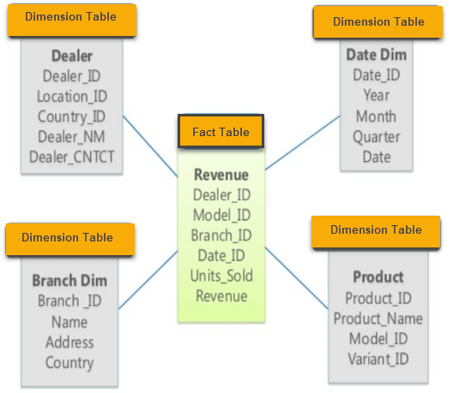
Example

Slide 7
Steps for DM
1. Identify the Business Process:
Identifying the actual business process a datarehouse should cover. This could be Marketing, Sales, HR, etc. as per the data analysis needs of the organization.
2. Identify the Grain:
The Grain describes the level of detail for the business problem/solution like until what level data needs to be updated.
3. Identify the Dimensions:
Dimensions are nouns like date, store, inventory, etc. These dimensions are where all the data should be stored. For example, the date dimension may contain data like a year, month and weekday.

Slide 8
Steps for DM
4. Identify the Fact:
Most of the fact table rows are numerical values like price or cost per unit, etc.
5. Build Schema:
In this step, you implement the Dimension Model. A schema is nothing but the database structure (arrangement of tables). There are two popular schemas
i. Star
ii. Snowflake

Slide 9
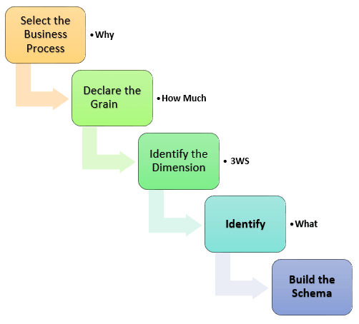
Steps for DM

Slide 10
Star Schema
It is called a star schema because diagram resembles a star, with points radiating from a center
The center of the star consists of the fact table, and the points of the star is dimension tables.
The PKs of Dim Tables are FKs of Fact tables.
The fact tables in a star schema is third normal form whereas dimensional tables are de-normalized.

Slide 11
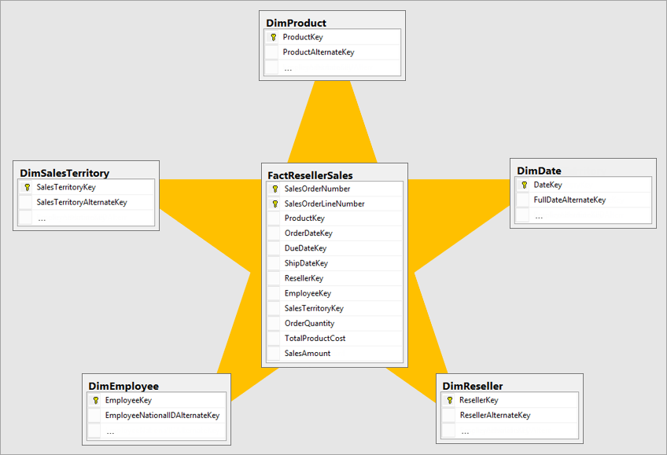
Star Schema

Slide 12
Snowflake Schema
The snowflake schema is an extension of the star schema.
In a snowflake schema, each dimension are normalized and connected to more dimension tables.

Slide 13
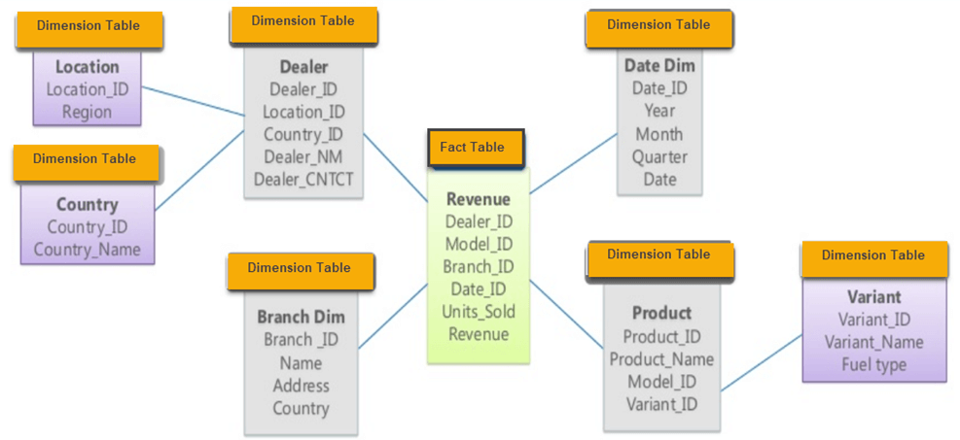
Snowflake Schema

Slide 14
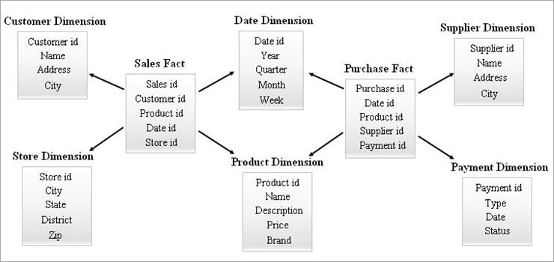
Galaxy Schema
Combination of multiple star schemas is called as Galaxy schema.

